Slide 1
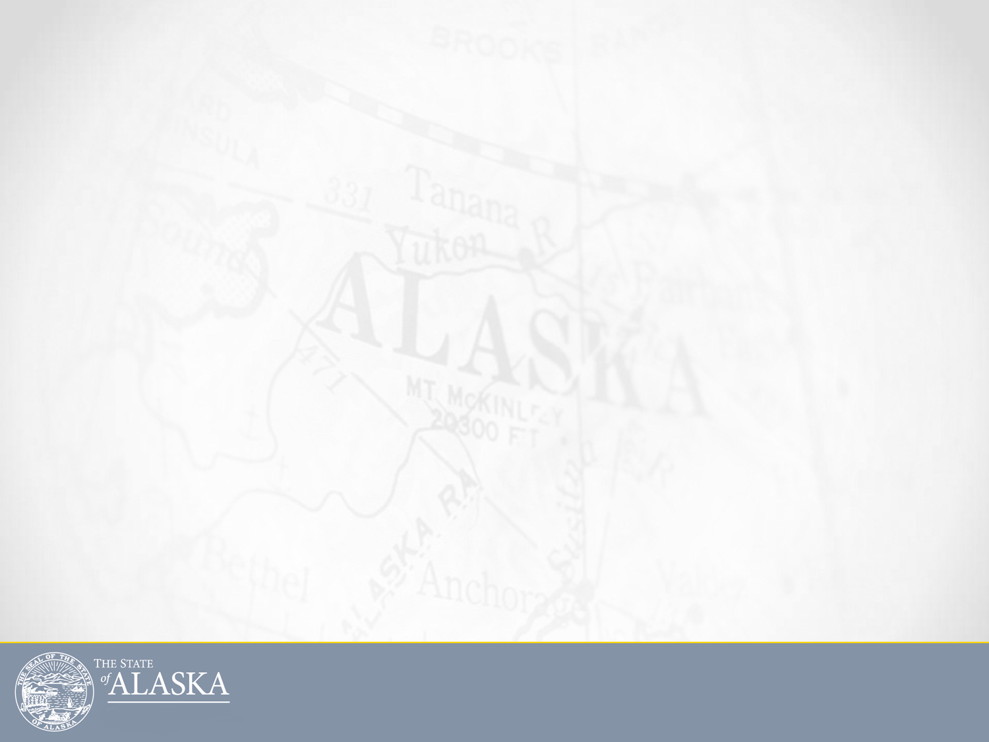
Governor Walker’s Fiscal Plan Overview
February 21, 2017
Office of Management and Budget
Pat Pitney, Director
Office of Management and Budget
www.omb.alaska.gov

Slide 2
Alaska’s Budget in Household Terms
Income has dropped more than 80%
Your annual income dropped from $80,000 to $16,000
Spending has been reduced 44%
You have been able to reduce your rent or mortgage, heat, food, every day travel, and vacations. You stopped building your cabin, stopped remodeling, and you’ll keep your old car.
Expenses have been cut from $80,000 to $45,000
Savings has one year remaining
You had $130,000 in the bank, but now only $25,000
Investment accounts have been growing steadily
You have $500,000 in an IRA and you need to decide whether to use it and how much you can prudently use
An income/spending gap remains
Office of Management and Budget
www.omb.alaska.gov

Slide 3
Governor Walker’s FY2018 Fiscal Plan
      The Governor’s FY2018 fiscal plan is comprised of three necessary elements this year to assure sustainable and balanced budgets long term.
      Continue to reduce state spending
      Draw from Permanent Fund earnings to support vital state services and protect the dividend
      Generate more revenue
Office of Management and Budget
www.omb.alaska.gov

Slide 4
The Budget Has Already Been Greatly Reduced
There has been $1.7 billion in unrestricted general fund cuts since FY2015.
The FY2018 unrestricted general fund agency operating budget is lower than the FY2011 budget.
Last year’s and this year’s capital budgets, $96 million and $115 respectively, were the first time the capital budget was below $120 million since FY2000, aside from FY2005 when there were general obligation bonds to cover capital projects.
There are fewer state employees now than there were 14 years ago in 2002, even though there are 15 percent more Alaska residents using state services.
Office of Management and Budget
www.omb.alaska.gov

Slide 5
A Few of State’s Services
DOT Plowed & Maintained 5,612 miles of roadway
DOT Operated 242 airports
Troopers responded to 114,933 calls and 467 search & rescue efforts
Public Defenders served 23,529 Alaskans
Reinsurance program: Keeps health insurance rates low for 24,064 Alaskans
Education funding for 138,000 K-12 students in 570 schools
Collect and Distribute child support payments for 121,600 Alaskans
Military & Veterans Affairs responded to 36 emergencies
Domestic Violence grants provided 108,975 nights of safe shelter
4,794 degrees conferred at the University
1,800 homeless were served by shelters
Firefighters responded to 552 fires
Provide Medicaid insurance to 178,000 Alaskans
562 Seniors living in Pioneer Homes
Children’s services helped 33,302 children
Office of Management and Budget
www.omb.alaska.gov
5
5
5
5

Slide 6

FY2018 Budget by All Fund Sources
Total Federal Funds
$3,442.3 33%
Total Unrestricted GF 49%
$5,026.5
Dollars in millions
TOTAL w/o PFD: $9.5 billion
TOTAL w/ PFD: $10.2 billion
Office of Management and Budget
www.omb.alaska.gov

Slide 7
FY2018 Unrestricted General Fund Spending With Dividends: $5.0 Billion
Dollars in billions
Office of Management and Budget
www.omb.alaska.gov
Notes:
Existing UGF includes dividend revenue from ERA

Slide 8
FY2018 Unrestricted General Fund
Agency Operating Budget
Dollars in millions
Office of Management and Budget
www.omb.alaska.gov
Notes:
Health, Life, Safety, Justice = OPA, PD, Corrections, Law’s criminal division, DPS, HSS, Courts

Slide 9
Spending on Major Items FY2013 Compared to FY2018
Dollars in millions
Dollars in millions
Office of Management and Budget
www.omb.alaska.gov

Slide 10
Agency Reductions
Unrestricted General Fund Reduction by Agency
FY15 Management Plan to FY18 Governor
Dollar Reduction ($millions)
Percentage Reduction
Commerce*
Labor & Workforce Develop
Fish & Game
Military & Veterans' Affairs
Natural Resources
Environmental Conservation
Governor
Revenue
Transportation*
Administration
Law
Legislature
Health & Social Services
Corrections
University of Alaska
Public Safety
Education & Early Develop
Judiciary
Dollars in millions
Office of Management and Budget
www.omb.alaska.gov
Notes:
Commerce adjusted to remove tourism
DOT adjusted for motor fuels

Slide 11
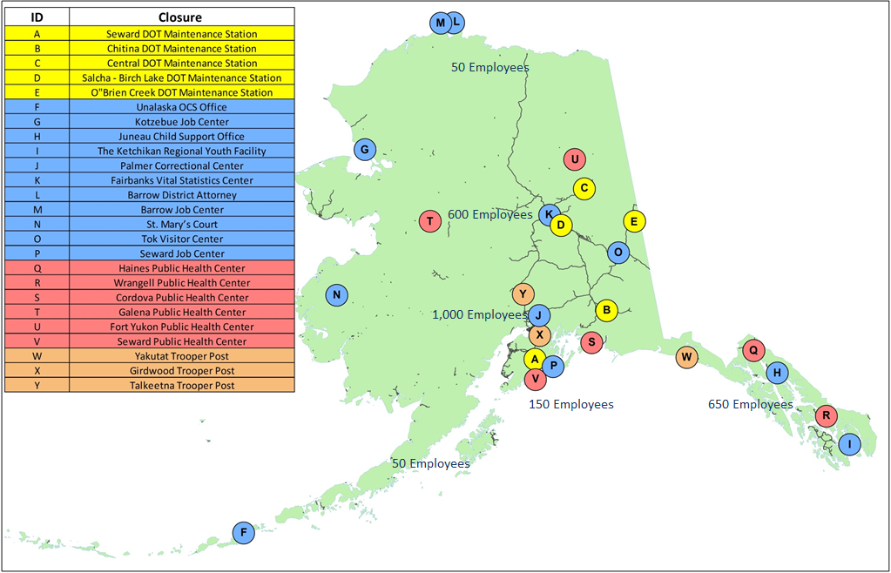
Closures Throughout the State
Office of Management and Budget
www.omb.alaska.gov

Slide 12
Fairbanks: Examples of Direct State Funding
School Formula: $119.5 million
School Pupil Transportation: $12.3 million
School Debt: $13.1 million
PERS/TRS: $14.8 million
  Fairbanks North Star Borough: $1.1 million
  Fairbanks NSB School District: $13.3 million
  City of Fairbanks: $0.4 million
Community Revenue Sharing: $3.2 million
  City of Fairbanks: $1.0 million
  Fairbanks North Star Borough: $2.2 million
Office of Management and Budget
www.omb.alaska.gov
12
12
12
12

Slide 13
Fairbanks: Examples of Other State Impacts
Payments to recipients in Fairbanks
AHFC Housing Programs: $5.4 million
AK Temporary Assistance: $1.9 million
Child Care Benefits: $2.5 million
Community Developmental Disability Grants: $2.1 million
Behavioral Health Prevention/Intervention/Treatment/Recovery Grants: $8.3 million
Adult Public Assistance: $6.1 million
General Relief Assistance: $1.9 million
Food Stamps: $12.8 million
PFD: $85.0 million
Senior Benefits: $2.2 million
WIC: $5.8 million
Foster Care: $3.4 million
Subsidized Adoptions: $3.0 million
Other State Operations
Pioneer Home: $9.9 million
Division of Juvenile Justice: $7.4 million
University of Alaska Fairbanks: $426.8 million
Office of Management and Budget
www.omb.alaska.gov
13
13
13
13
Notes:
UAF UGF $144.8 million

Slide 14
Revenue Measures
FY2018 Governors Proposal
Permanent Fund Protection Act
Motor Fuels Tax Increase
Additional measure needed to bridge the gap – work with the legislature for acceptable solution
Income tax or sales tax
Corporate tax increase
Oil tax credits reform and/or tax change
Office of Management and Budget
www.omb.alaska.gov
Notes:
Very similar to the Senate passed bill from 2016 (SB128)
Modified percent of market value structure
Every year 5.25% of the average balance is drawn
80% goes to the general fund
20% goes to the dividend
Dividend is supplemented by 20% of resource royalties
Makes the dividend more responsive to price increases and new production (including LNG exports)
5.25% is a sustainable draw amount long term with the following assumptions
1. Permanent Fund lifetime annual earnings average 10%, Callan consultants project PF earning need to be 6.9% for draw to be sustainable
2. When oil revenue exceeds $75/bbl, the draw is reduced by the same amount as additional revenue generated by higher prices
3. Draw amount reviewed on a three-year cycle for necessary adjustments

Slide 15
Future Reserve Balances
 | Governor's Plan ($B) |  |  | Status Quo
 | FY2019 | FY2022 | FY2027 | FY2019 | FY2022 | FY2027
CBR Balance | $ 6.6 | $ 7.8 | $ 10.3 | 0 | 0 | 0
ERA Balance | $ 8.0 | $ 8.0 | $ 8.2 | $ 9.3 | $ 2.3 | 0
Permanent Fund | $ 57.0 | $ 61.5 | $ 69.9 | $ 56.5 | $ 53.2 | $ 43.8
CBR/SBR savings peaked at $16.3B in FY2013, after the last five years of deficits, an estimated $2.1B will exist at the end June 2018.
Governor’s plan restores CBR and begins sustainable draw on the ERA effective in FY2017.
Governor’s Plan maintains the real value of the Permanent Fund and preserves an adequate balance in the CBR.
Under Status Quo the CBR is empty in November of FY2019 and the ERA is empty in late FY2023. Permanent fund looses value and corpus would be at risk.
Office of Management and Budget
www.omb.alaska.gov
15

Slide 16
Active Discussions in Juneau?
Four Different Earning Reserve Plans
  Governor’s, Seaton, Stedman, Dunleavy
  Considerations
      Rule Based
      Preserve Permanent Fund Value
      Minimize Volatility
      Dividend Size
Spending Level
Oil and Gas Taxes and Credits
Motor Fuels Tax
Sales Tax
Session length
Office of Management and Budget
www.omb.alaska.gov
16

Slide 17
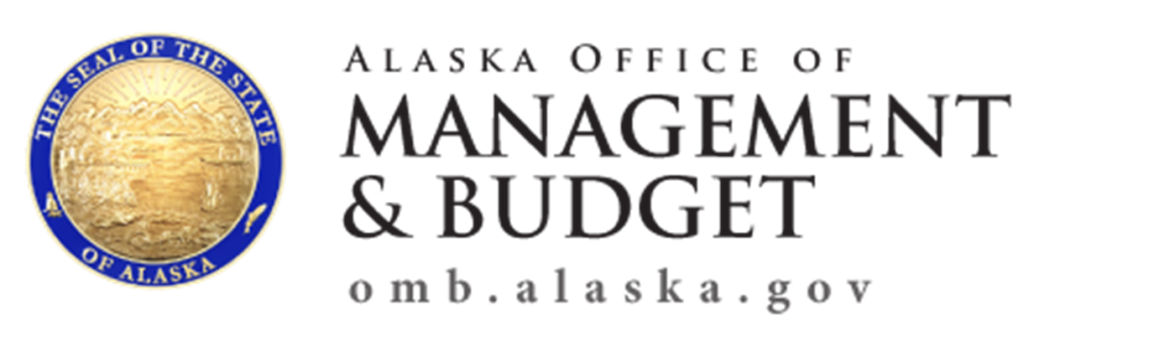
For more information on the budget
Pat Pitney, Director
Office of Management and Budget
907-465-4660
Email: Pat.Pitney@alaska.gov
Office of Management and Budget
www.omb.alaska.gov

